Slide 1
MSnake Sensor based Game
By
Aditya Deshpande
TejKiran Meka
Jagadish Rao
Mahesh Vemula

Slide 2
Project Phases
Sensor Data Collection
Training Data
Human activity recognition
Invoke touchevent based on human activity
Storing and retrieving activity results

Slide 3
Data Collection
Data is received from sensor tag using bluetooth connectivity and stored in HBase.
Track parameters like xyz coordinates of accelerometer sensor, temperature sensor data, humidity sensor data.

Slide 4
Training Data
Sensor data collected is trained using Hidden Markov Model(HMM)
Data collected for motion activity is converted to respective sequence files.
Based on these sequence files human motion activity is detected

Slide 5
Testing/Analyzing human activity
When the app gets started train method is invoked in onlescan() method.
Real Time sensor data is collected only if the detected accelerometer data value is greater than threshold value.
Probability is caluclated between the real time seq file and traning seq files.

Slide 6
Testing/Analyzing human activity
Motion human activity is detected based on the highest probability of real and testing seq file.

Slide 7
Invoke touch event based on Human Activity
Detected human motion activity is broadcasted through intents in the application.
Motion activity is received and respective method is invoked
For example if motion detected is right, then function which makes the object to move right is invoked.

Slide 8
Storing and Retrieving Activity Results
Track number of activities the user has performed.
Use HBase to store and retrieve activity results.
Track results based on per session.

Slide 9
Evaluation of Model
We trained 10 samples for each activity.
Samples are collected for up-down, down-up, right-to-left, left-to-right activities are connected.
All the samples are converted to sequence files and used for calculating probability using HMM with testing data files

Slide 10
Evaluation of Model
After training for testing we collected 20 samples of each activity are collected
Our result confusion matrix

Slide 11
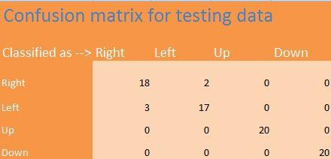

Slide 12
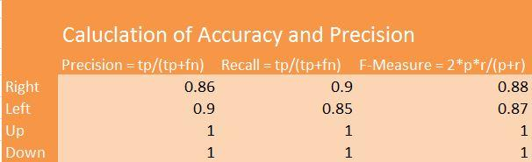

Slide 13
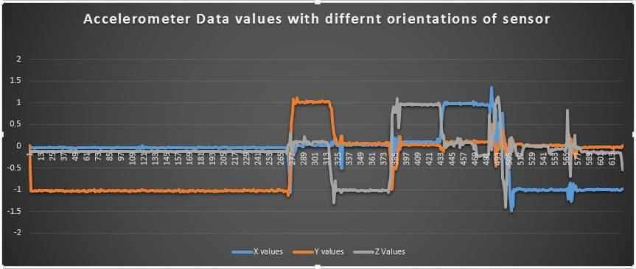
Data Plot

Slide 14
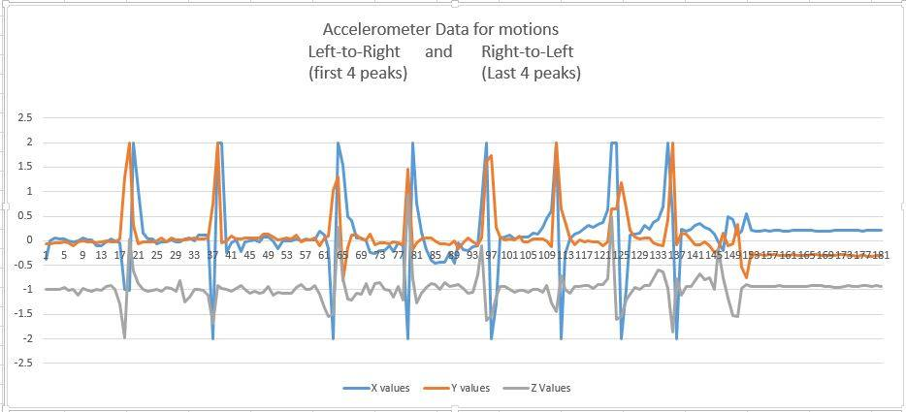

Slide 15
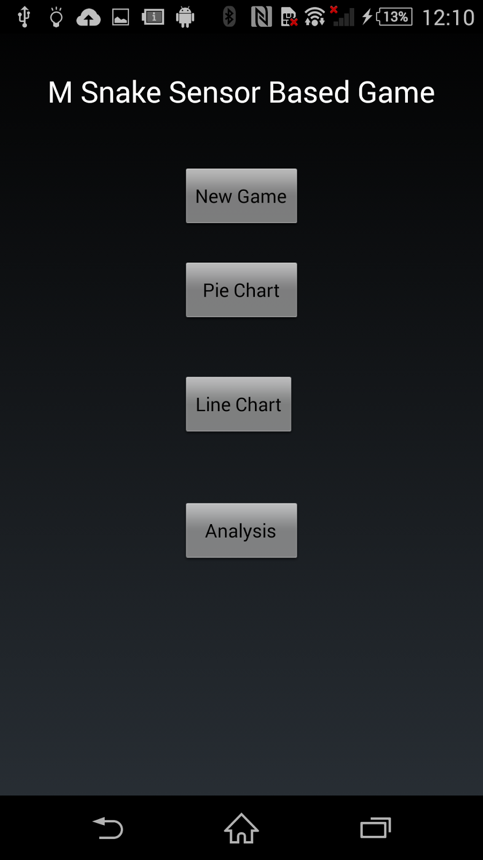
Screen Shots of the application

Slide 16
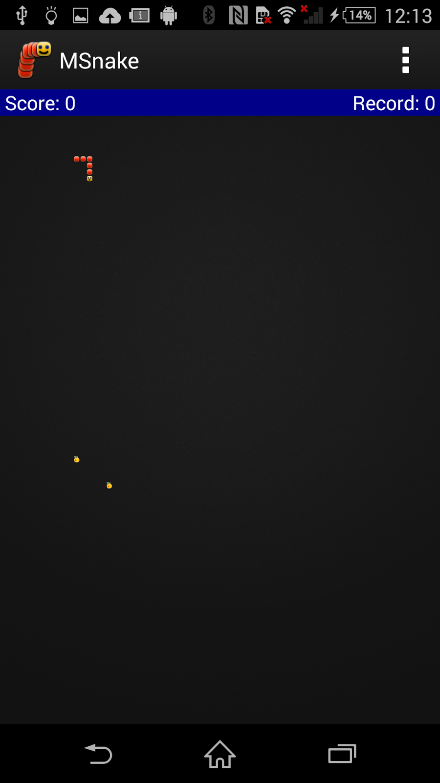
Game

Slide 17
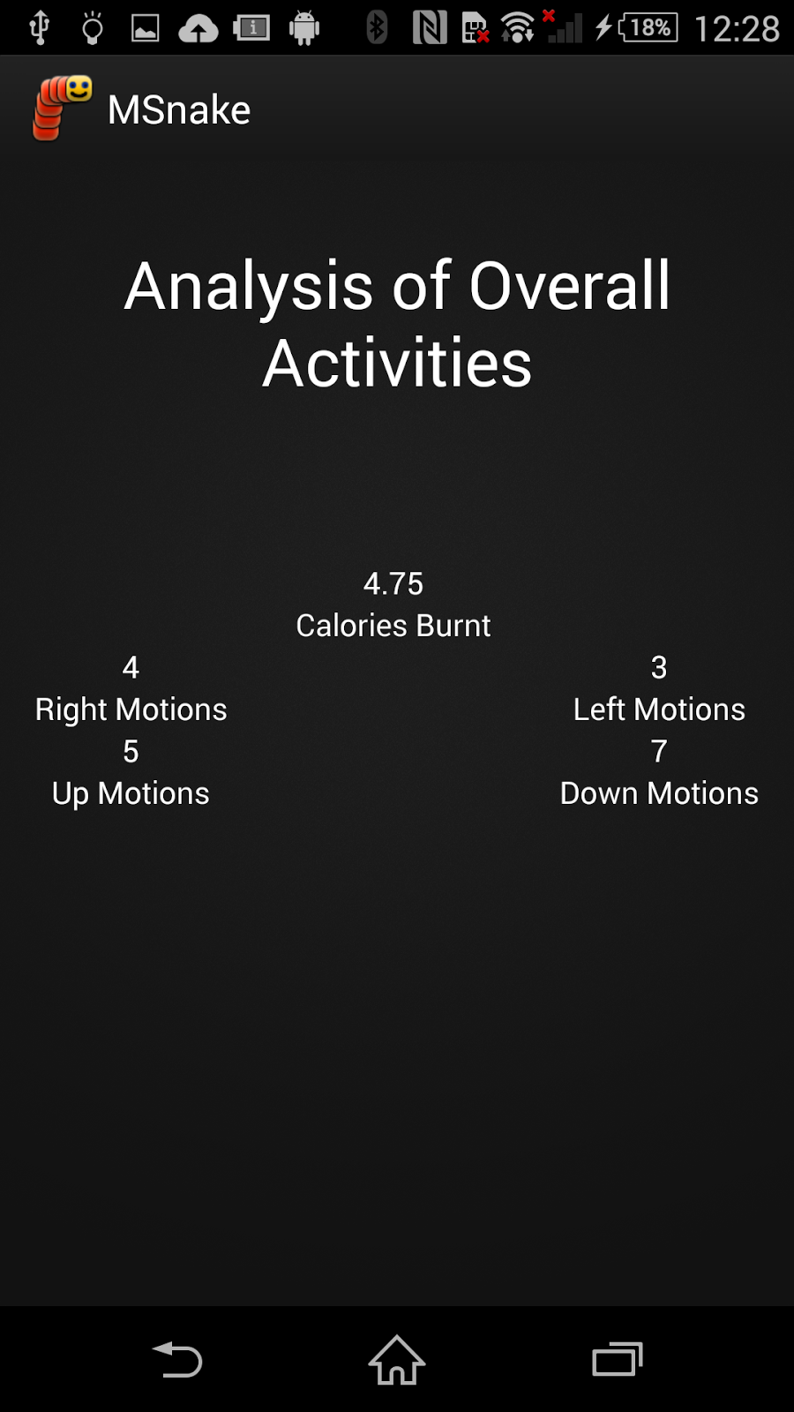
Analysis

Slide 18
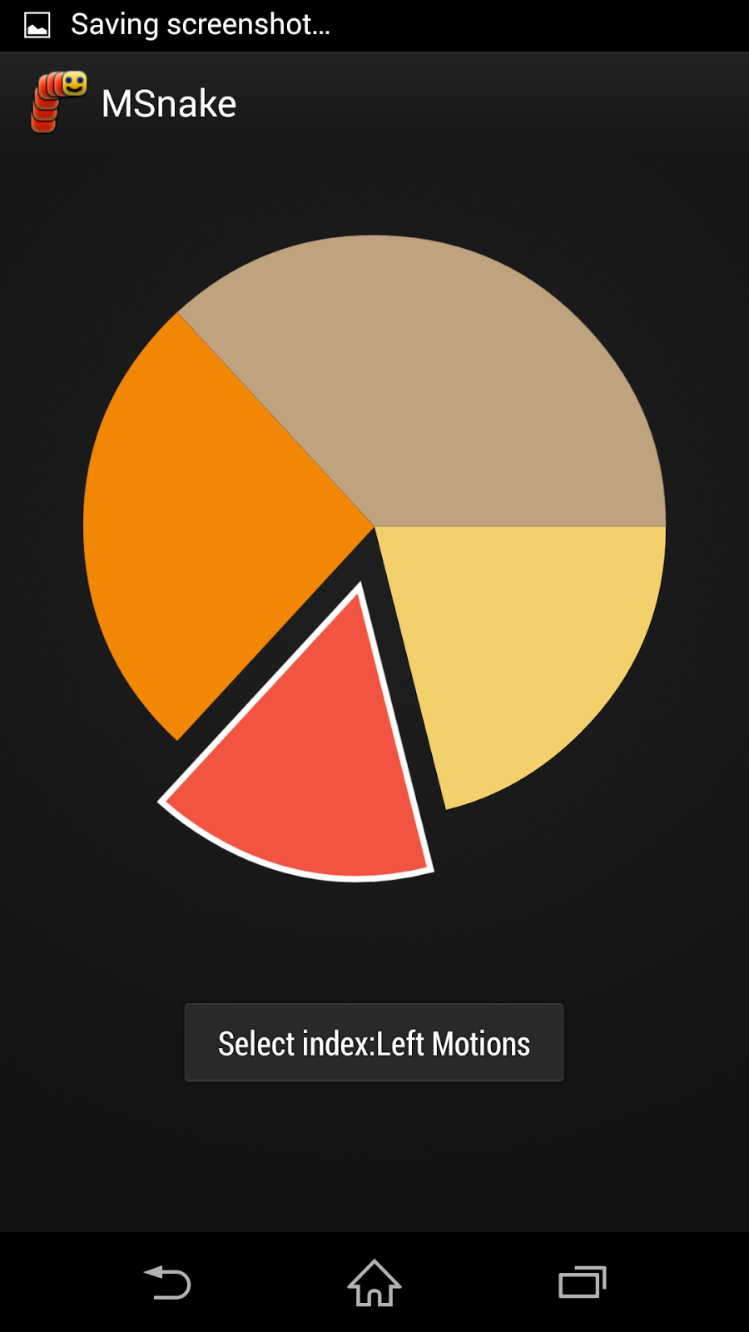
Pie Chart

Slide 19
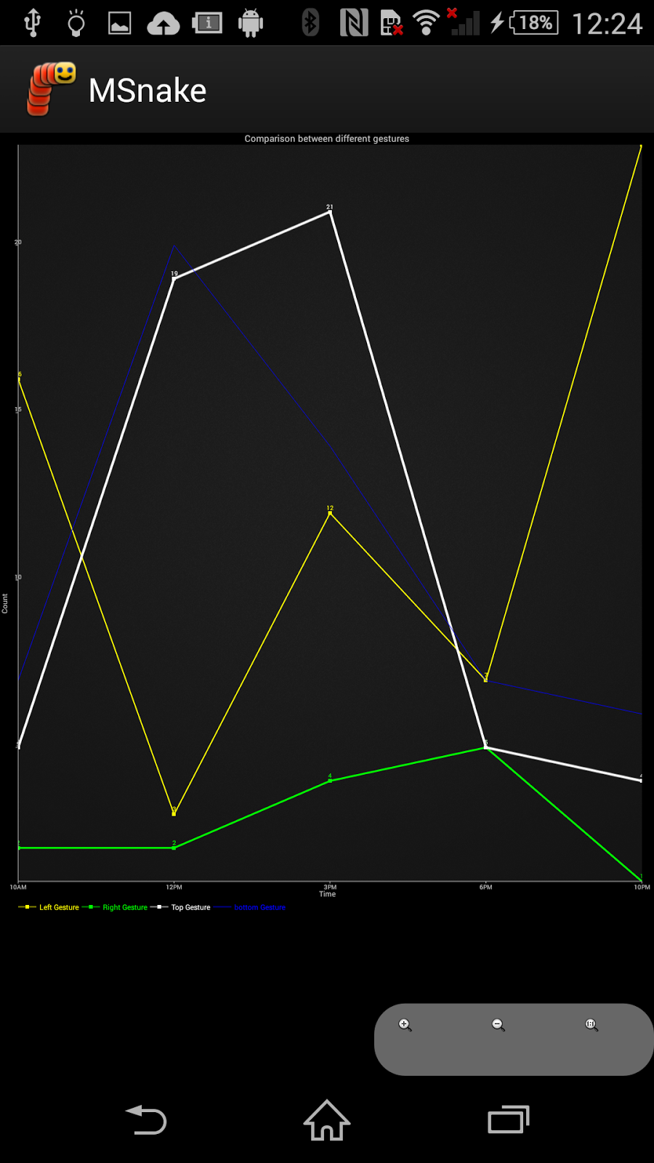
Line Chart

Slide 20


Slide 21


